Slide 1

Predicting customer buying behaviour
24/12/2022

Slide 2
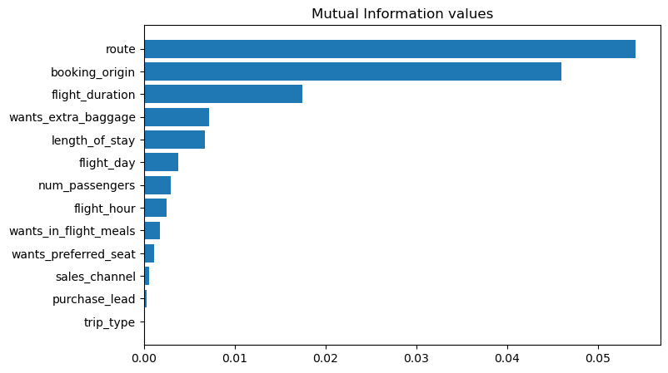
The predictive model with factors that influence buying behaviour
We have trained the data set with the Random forest classifier model and received
ACCURACY: 85.37
AUC score: 0.568
route
booking_origin
flight_duration
wants_extra_baggage
length_of_stay
are the top 5 features that influence
Customer buying behavior.

